Slide 1
The Price is Right? A deep dive into Hospital Cost Reports
Matthew Maughan
PhD Student, Health Services Research
19 April 2026

Slide 2
Agenda
My research question and the search for a valid price
A background on the Hospital Cost Reports (HCRIS)
A tale of two pricing methods
A deep dive into the outliers
Takeaways and Next Steps
Some helpful hints on replication

Slide 3
The Research Question

Slide 4
The Maryland Model and its discontents
The context | Maryland has operated a unique reimbursement model for its hospitals since 1977 The model is controversial, particularly on its pricing for health services in both Commercial and Medicare segments
The research question | How do prices for hospital services in Maryland compare to other states, all else equal? All else equal implies a standardized bundle of services and patient population. Parameters like quality etc. out of scope
The desired estimand | Case-mix adjusted net reimbursement for discharge IN ENGLISH: A price for each hospital visit per payer type for each state that accounts for different mix of services provided

Slide 5
A price seems simple enough – what are the barriers?
1
2
True Prices at Service Level are Opaque
Transparency is Particularly bad in Maryland
3
4
Commercial info is fragmented and our reporting systems are built for Medicare
A “visit” is hard to define

Slide 6
The Data

Slide 7
Enter Hospital Cost Reports (HCRIS)
The center for Medicare and Medicaid Services (CMS) requires reporting of certain revenue, cost and utilization volume information for hospitals.
This information is pretty raw – multiple data aggregators to include the RAND corporation (CRO) and NASHP (National Academy of State Health Policy) both publish cleaned, aggregated, and processed versions of these cost reports.
Often supplemented with other data NOT publicly available
Useful variables are calculated from raw values, but different aggregators differ on which variables and how and are not always perfectly transparent

Slide 8

A useful schematic + what it reveals about data limitations
Audited Financial Statements
NASHP
PUBLIC
SEMI
PUBLIC
Hospital Cost Reports
EMMA
NFP hospitals w/ municipal bond debt
My analytical dataset
PRIVATE
Edgar
For profit hospitals
RAND
IRS form 990
Pro Publica
Commercial Claims
Notes:
Ok so what?
Because both main data aggregators mix public and private sources, neither are completely transparent
Both of them process the data to create new variable names. Some (RAND) are better about documenting what they did than others (NASHP)
NASHP on the other hand is more transparent about where the data came from – RAND just says that is it”enhanced” by other data sources

Slide 9
Three Files in Relational Database
Alpha File
Individual alphabetic character value on worksheet is unique identifier
Starts with cost report #, which is how its tied to report file
Report File
Cost Report # is unique identifier (1 filed per hospital per year
Cost Report should be unique to a hospital year, but sometimes there are exceptions (acquisition, fiscal year change etc)
Numeric File
Individual numeric character value on worksheet is unique identifier
Then worksheet, column, line, and finally value
Starts with cost report #, which is how its tied to report file
Then worksheet, column, line, and finally value

Slide 10
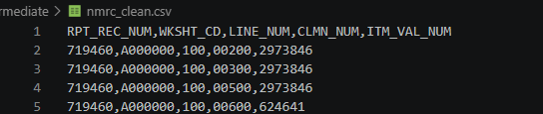
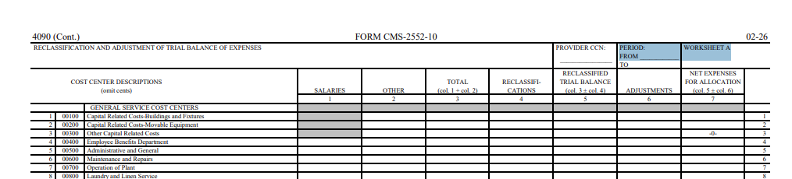
Worksheet values have a taxonomy corresponding to normalized database
2973846

Slide 11
Why does this matter for my question?

Slide 12
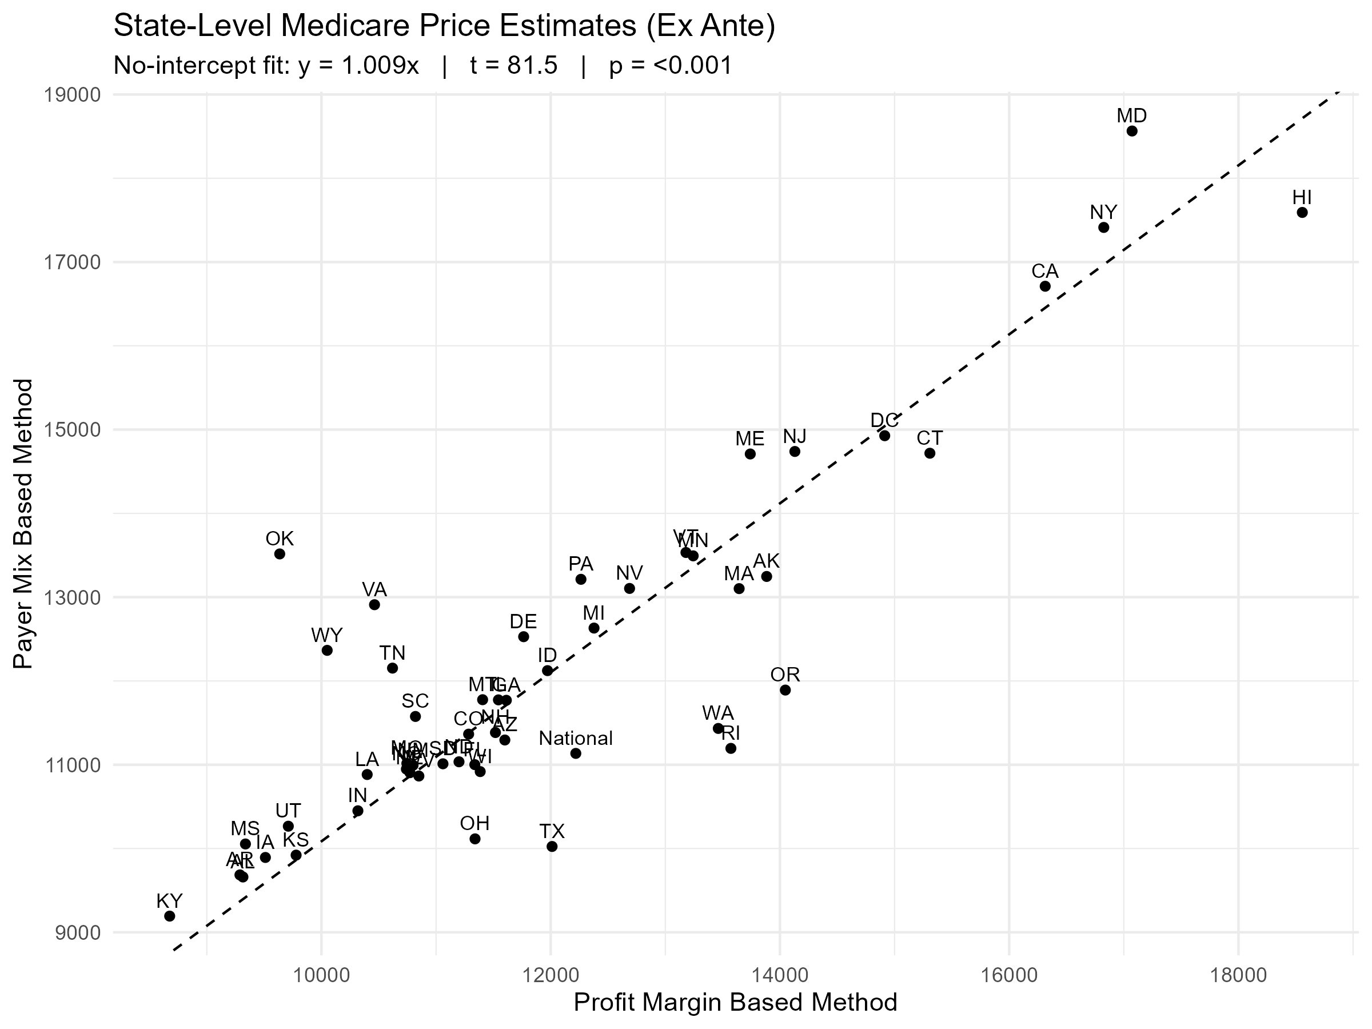
Use Case: What is the right (Medicare) price?
Why this matters
The data was calculated using my NASHP-RAND combined datafile mostly drawn from the underlying hospital cost reports
Clearly, these two methods are getting at the same underlying reality in the cost reports. BUT
Something is wrong with ~20% of states. Should I care? Does it matter?
Of course I should – My treatment state is one of the outliers!
If noise – this tells me which variables are unreliable
If bias – this tells me something important about heterogeneity among states.

Slide 13
Variable Derivation and Formula Breakdown
Profit Margin Method
Payer Mix Method
Variable | Aggregator
Hospital Operating Costs per Discharge (not broken out by payer, but Medicare centric) | NASHP
Medicare Specific Profit Margin | NASHP
Case Mix Index | RAND
Variable | Source
Medicare payer mix(% of discharges) | NASHP
Medicare Outpatient Revenue | RAND
Medicare Inpatient Revenue | RAND
Total Adjusted Discharges | NASHP
Case Mix Index | RAND
Revenue per Adjusted Discharge=
Hospital Operating Costs/(1-Profit margin)
Case Mix Index
Revenue per Adjusted Discharge=
Total Revenue/(Total Adjusted Discharges*Medicare Payer Mix)
Case Mix Index

Slide 14
How I reconstructed them
Profit Margin Method
Payer Mix Method
Variable | Input Values
Hospital Operating Costs per Adjusted Discharge (not broken out by payer, but Medicare centric) | 3 Potential Total Cost Measurements Inpatient Discharges easy enough + Medicare Revenue
Medicare Specific Profit Margin | 3 Potential Medicare Specific Cost measurements (not even sure if mutually exclusive) “Medicare PartA payment”(revenue) “Medicare PartB payment”(revenue
Case Mix Index | I didn’t – not available in raw form
Variable | Input Values
Medicare payer mix(% of discharges) | NASHP
Medicare Outpatient Revenue | “Medicare Part B payment” (revenue)
Medicare Inpatient Revenue | “Medicare Part A payment” (revenue)
Total Adjusted Discharges | Inpatient Discharges easy enough – but adjustment requires many assumptions of revenue by line item
Case Mix Index | I didn’t – not available in raw form

Slide 15
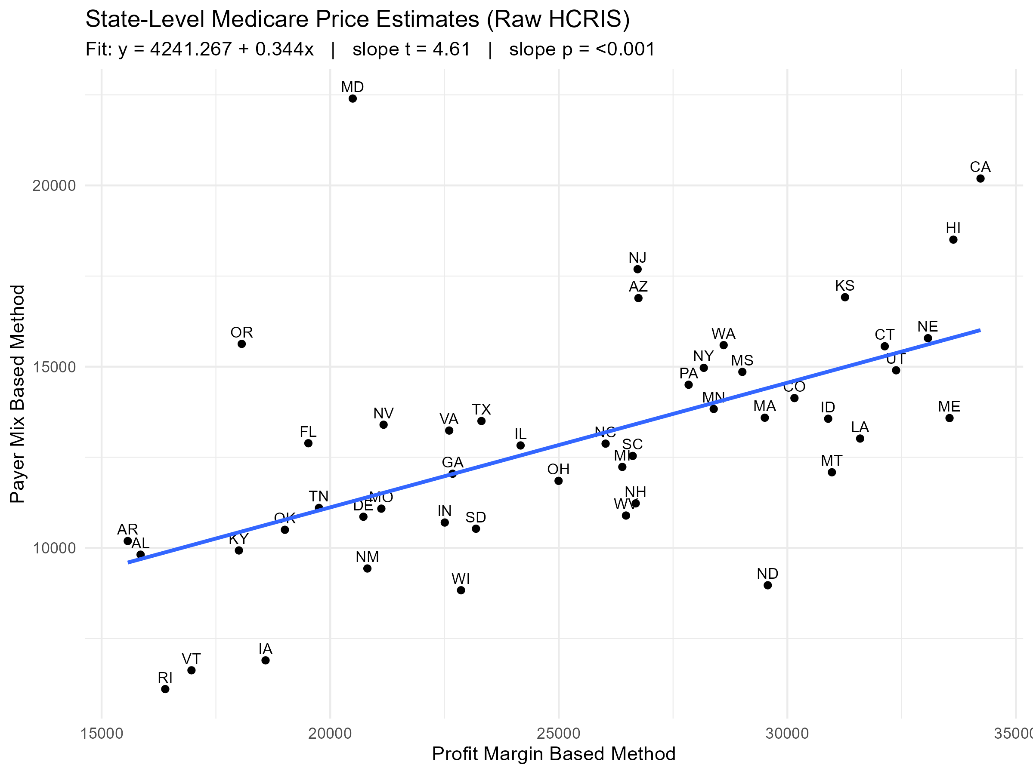
What I found from the raw cost reports vs previous analysis

Slide 16



Not quite there yet…..

Slide 17
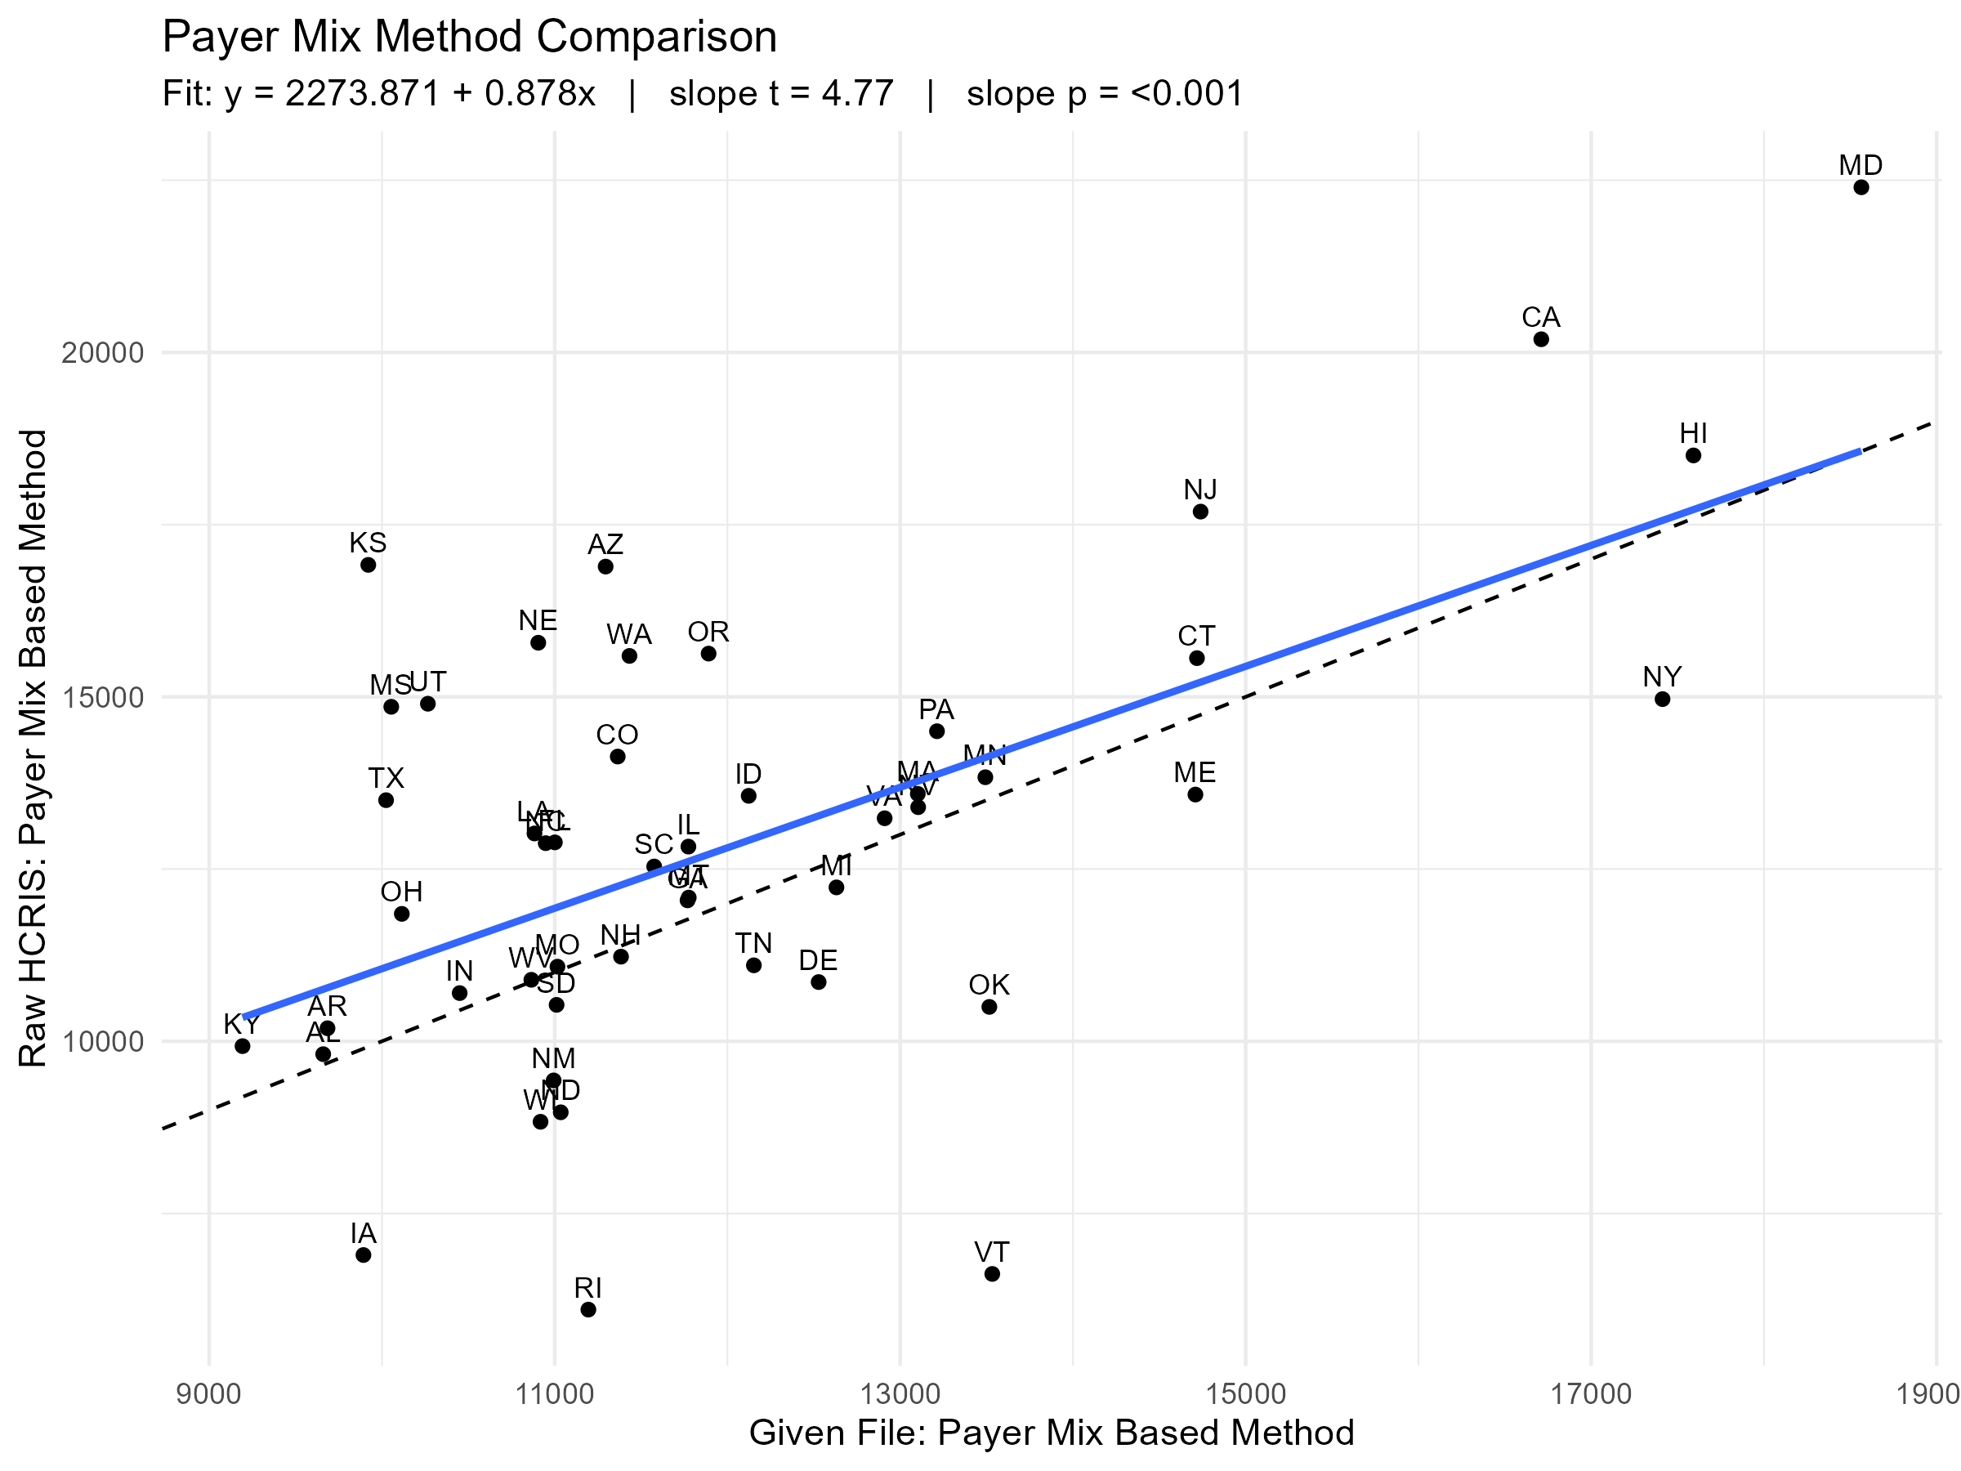
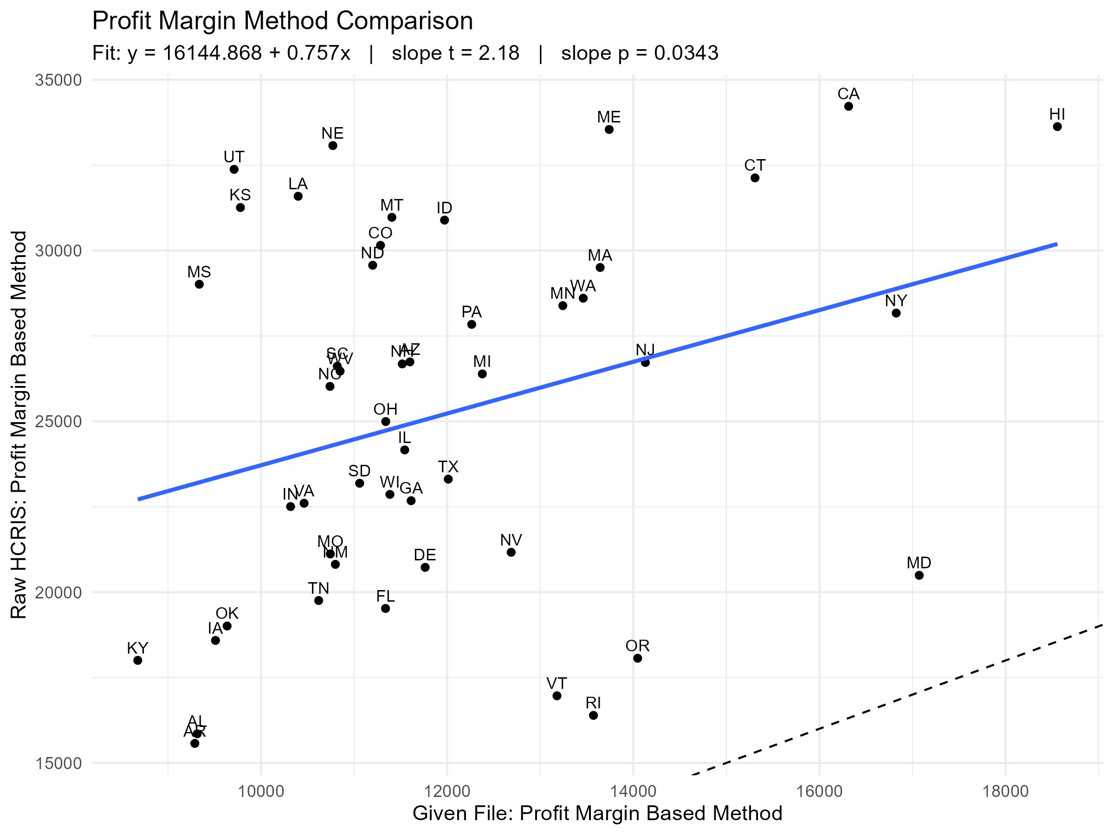
Now let’s compare same method across different data aggregations

Slide 18
So what have we learned
Both estimates are wrong… but the profit margin method is… more wrong, in both bias and noise
Hospital Operating Costs are built off Medicare assumptions – payer heterogeneity likely not the issue
Both methods contained both RAND and NASHP derived figures
It’s the COST estimation that’s the problem. Both methods relied on revenue estimation – but profit margin relied on cost
This should make sense – realizing revenue is a more discreet identifiable transaction
Realizing costs is….fuzzier. Financial accounting (what you report for administrative purposes) vs. actual costs you realize (managerial accounting) are NOT THE SAME

Slide 19
Helpful tips for reproducibility
(this is all in the READme)

Slide 20
The HCRIS relational database
I did not upload this to my repo – too big. WAY too big
Website is in readme
You will download a zipfile that you have to unzip and put in my file structure
Three source files come from here
HOSP10_2022_rpt – this is your master primary key is the cost report number, NOT the hospital provider number
HOSP10_2022_alpha – all alphabetical variables tied to that cost report
HOSP10_2022_nmrc – all numeric variables tied to that cost report

Slide 21
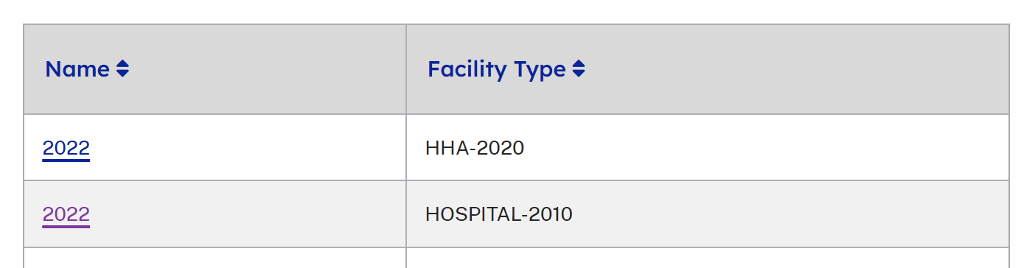
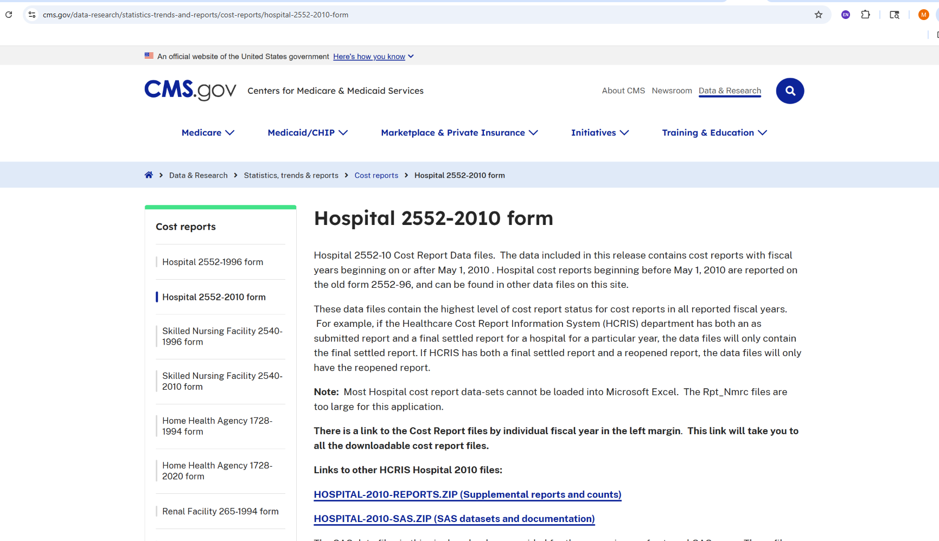
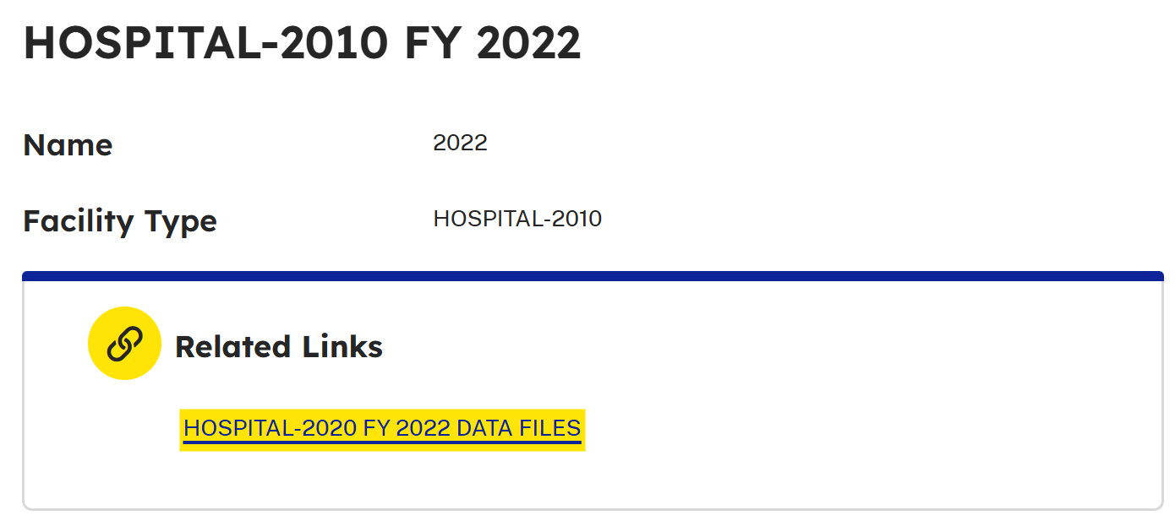
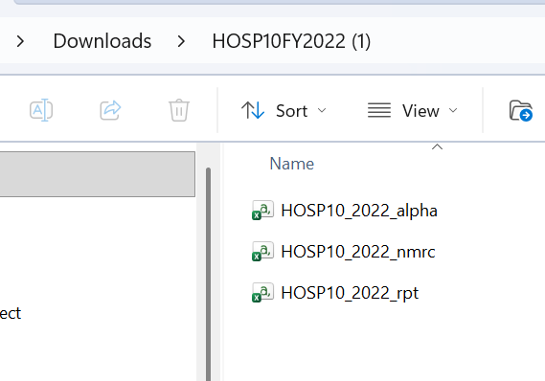

In screenshots

Slide 22
Additional Files I uploaded
Analytical_sample – a simple list of hospital identifier numbers. I already culled the set of all hospitals based on specific inclusion criteria. I condense the large report file based on this very early on
State_Price_Estimation_ExAnte – These are the estimates I have already produced from the aggregated files to which I am trying to compare cost reports.

Slide 23
Repo Folder Structure
/Source - these are unprocessed by any code in this repo. Both the data downloads above and the data I provide in my repo are here
/Intermediate - This is after processing but before outputs. These you will need to produce yourself from the code - as they are also too big to include
/Code
00_setup_file - this establishes directories
01_HCRIS_inspect - ensures data uploaded with correct fields, formats etc
02_import_cleanrpt – cleans and joins to analytical sample
03_working_rpt - this is the workhorse code file - all analysis and outputs done here

Slide 24
What to reproduce
I am asking to reproduce the 4 scatterplots found in the output file and shown in this presentation - might be helpful to append your initials so you can compare yours to the original

Slide 25
Questions?

